Slide 1
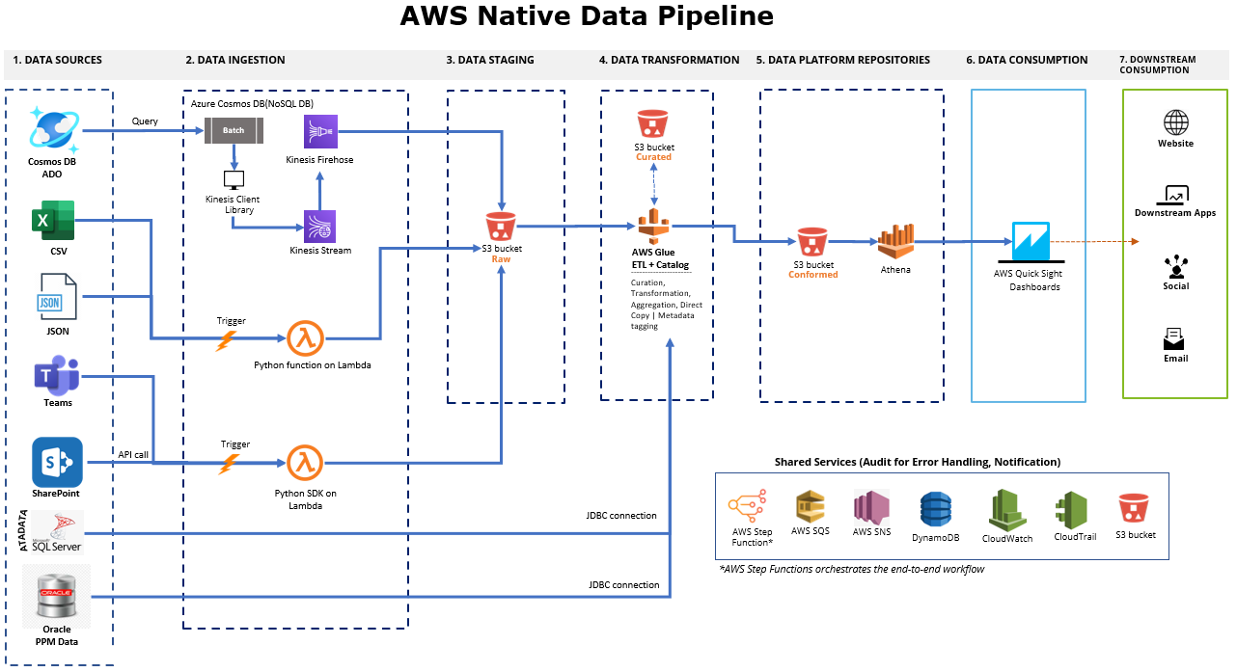

Slide 2













On Premise
Data Analytics on AWS
AWS Step Functions workflow
Curated Data
Raw Data
AWS Lambda
Check status of Glue ETL
Processed Data
AWS S3
JSON Files
RedShift
Download Files
From SharePoint
Initialize
Job Details
Perform
CSV to JSON
Choice Step
Run another Glue ETL Job?
AWS S3
Confirmed Files
AWS S3
Curated Files
AWS Glue
Transform/Processing
Initiate Raw
Data Population
AWS S3
CSV Files
Invoke
Glue Crawler
CSV Files
AWS Athena
On Premise
DBs (JDBC)
Pull Data from
Cosmos DB
Kinesis Streams &
Fire Hose
AWS Lambda
Check status of Crawler
Pass Step
Initialize Glue ETL Job
AWS Lambda
Invoke Glue ETL Job
QuckSight
Charts/Dashboard
AWS Common services
API IAM
CloudWatch
CloudTrail
Code Pipeline
AWS SQS
CloudFormation
AWS SNS
AWS S3
DynamoDB

Slide 3
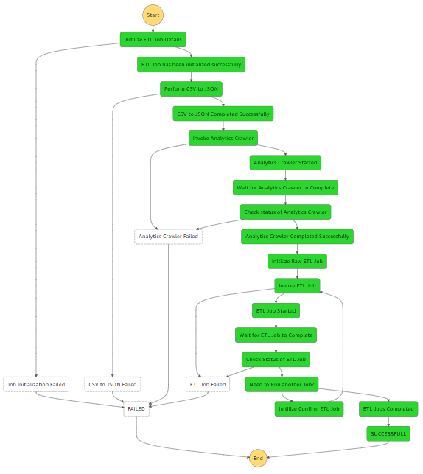
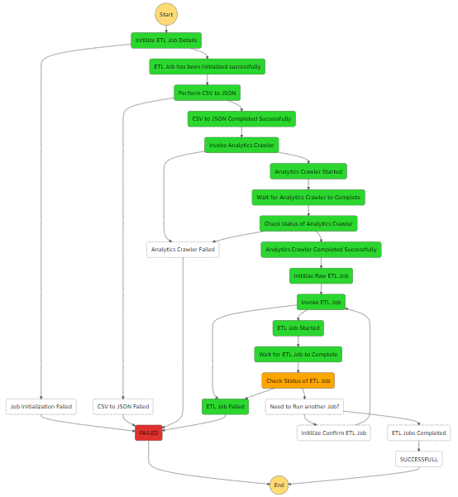
AWS Step Function Execution Flow

